Slide 1
Access rights and copyright declarations for digital objects
Yoel Kortick
Senior Librarian

Slide 2
Introduction
The default digital access rights policy
Configuring Access Rights Policies – the examples
Configuring Access Rights Policies example one
Configuring Access Rights Policies example two
Copyright declarations

Slide 3
Introduction

Slide 4
Introduction
Access rights define the conditions that must be fulfilled in order for patrons to access digital resources.
In addition to this presentation see also Configuring Access Rights Policies example one for Digital Objects

Slide 5
Introduction
For example, it is possible to define that for a specific digital resource
  Only patrons from a specified user group, such as “graduate students” and “faculty” can access the digital object
  Only patrons coming from a specific ip address (for example an IP of the university computer system) can access the digital object
  Only patrons with specific user IDs can access the digital object

Slide 6
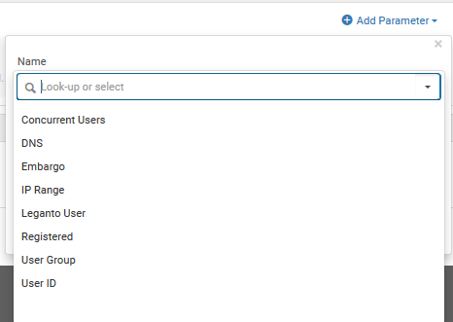
Introduction
These are the parameters by which access rights policy rules can be created.
An explanation of each may be found at Adding an Access Rights Policy.

Slide 7
The default digital access rights policy

Slide 8
The default digital access rights policy
If no specific digital access right policy is defined for a digital object then a default policy is used.
For example we see on the next slide that for article “Research status and characteristics of library and information science in Taiwan: a bibliometric analysis” from Scientometrics (2012) 92:7–21, there is no access rights policy.
Therefore the default will be used.

Slide 9
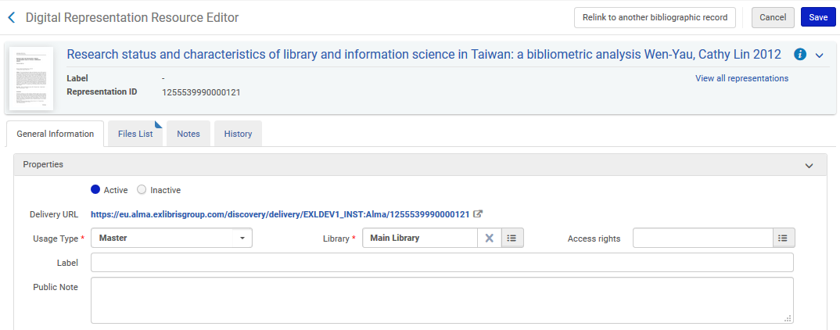
The default digital access rights policy
No access rights policy defined

Slide 10
The default digital access rights policy
The default access rights policy is defined in the parameter access_right_default_policy which is accessible at Configuration Menu > Resources > General > Other Settings).
Possible values:
  Restrict – All users are restricted from accessing the specified digital object
  Allow – All users are allowed to access the specified digital object

Slide 11

The default digital access rights policy
Currently the value is “allow”

Slide 12
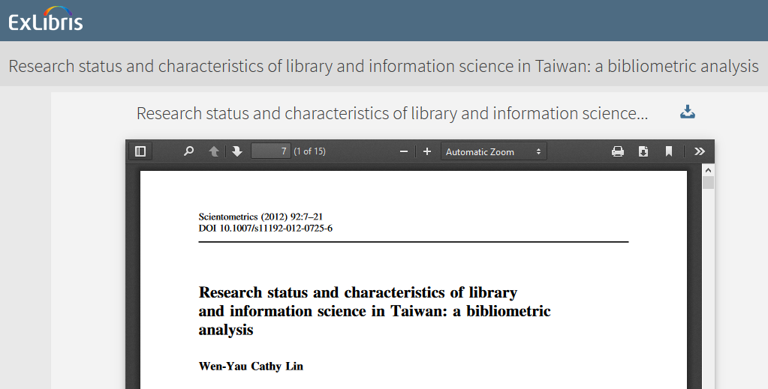
The default digital access rights policy
The article with no access rights policy is therefore accessible in Primo

Slide 13
The default digital access rights policy
If however we change the policy to “Restrict”

Slide 14
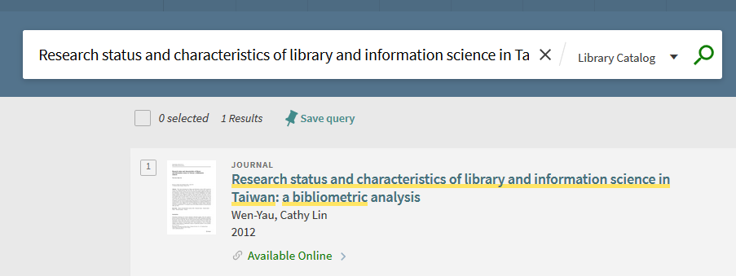
The default digital access rights policy
Then we can see the bibliographic record …

Slide 15
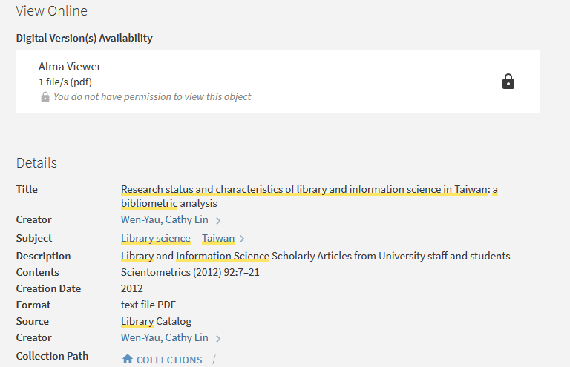
The default digital access rights policy
But we cannot view the digital object
No permission to view the digital object

Slide 16
Configuring Access Rights Policies – the examples

Slide 17
Configuring Access Rights Policies – the examples
We will now show two examples.
In the first example users with user group faculty can access the resource. Other user groups, as well as users who have not logged in, cannot access the resource.
In the second example any user who is logged in can access the resource (regardless of user group). All users who have not logged in cannot access the resource.

Slide 18
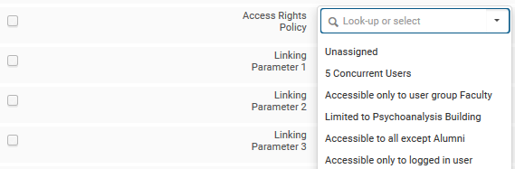
Configuring Access Rights Policies – the examples
In both of our examples we will update the access rights manually. It is also possible to globally update the Access Rights by creating a digital titles set and running the job “Global Representation Changes” on the set.

Slide 19
Configuring Access Rights Policies example one

Slide 20
Configuring Access Rights Policies example one
Access rights policies are configured on the “Access Rights Policy List” page.
This is accessed at “Configuration > Fulfillment > Copyright Management > Access Rights”.

Slide 21
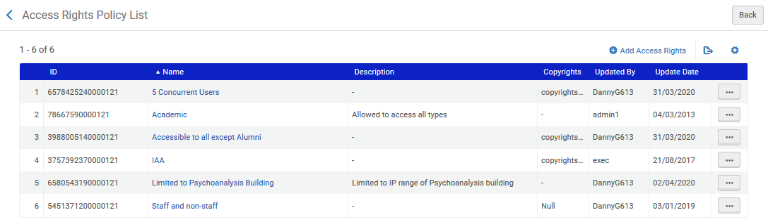
Configuring Access Rights Policies example one
The “Access Rights Policy List” page.
We will now add a new policy

Slide 22
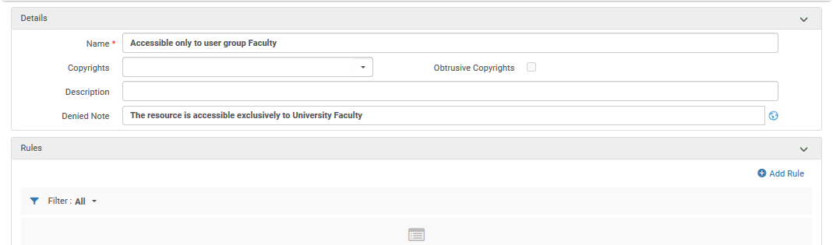
Configuring Access Rights Policies example one
We have called the new policy “Accessible only to user group Faculty”. We will now add a rule stating that only users with user group faculty will be able to access objects with this policy
We will discuss the copyrights later in the presentation
We will later see the “Denied Note” in use
Let’s add a rule

Slide 23
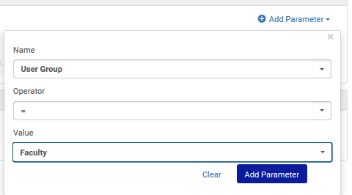
Configuring Access Rights Policies example one
First we will define that the user group will = “Faculty”.

Slide 24
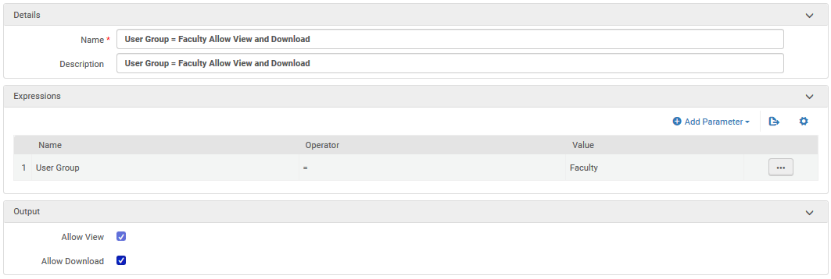
Configuring Access Rights Policies example one
If the user group = Faculty
Then allow view and download

Slide 25
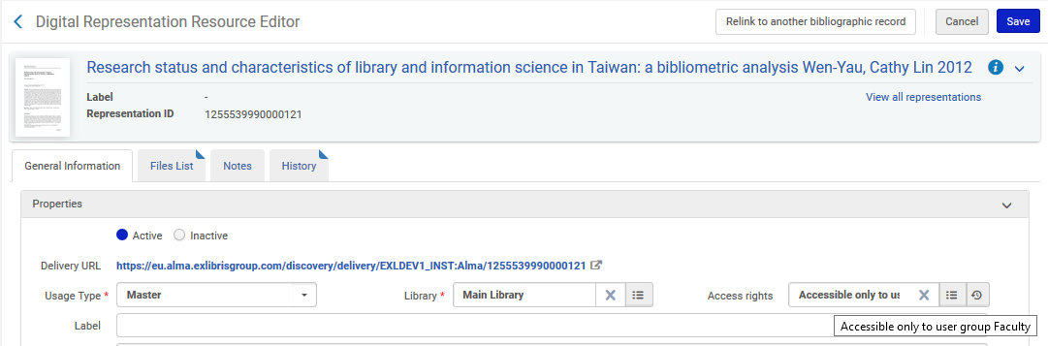
Configuring Access Rights Policies example one
The new access right policy has been added to representation for title “Research status and characteristics of library and information science in Taiwan…”

Slide 26
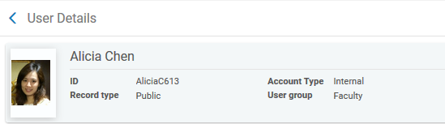
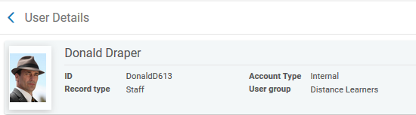
Configuring Access Rights Policies example one
User Alicia Chen is user group “Faculty”
User Donald Draper is user group “Distance Learner”

Slide 27
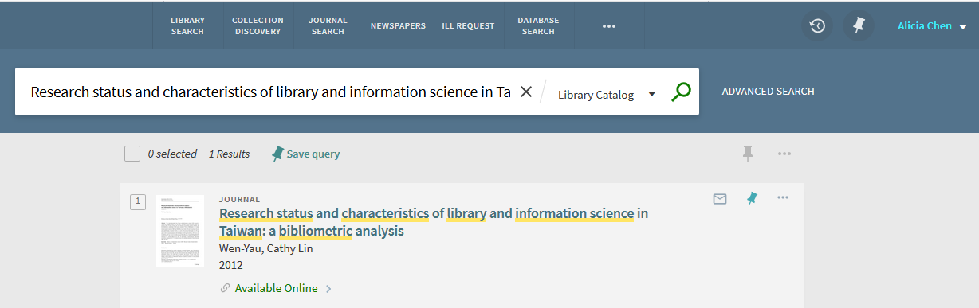
Configuring Access Rights Policies example one
Alicia tries to access the digital object

Slide 28
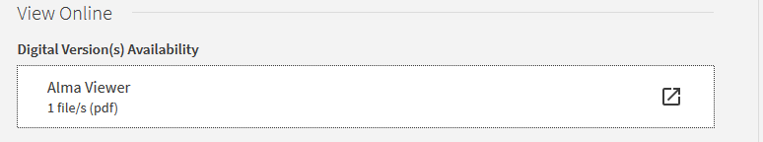
Configuring Access Rights Policies example one
Alicia can access the digital object

Slide 29
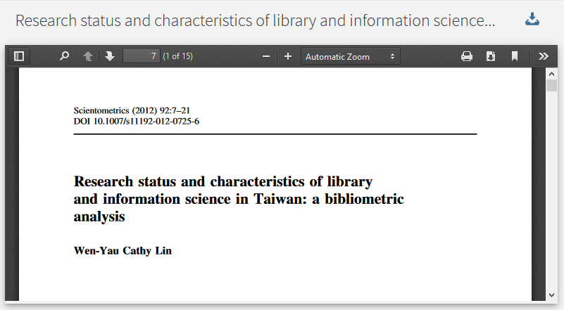
Configuring Access Rights Policies example one
Alicia accesses the digital object

Slide 30
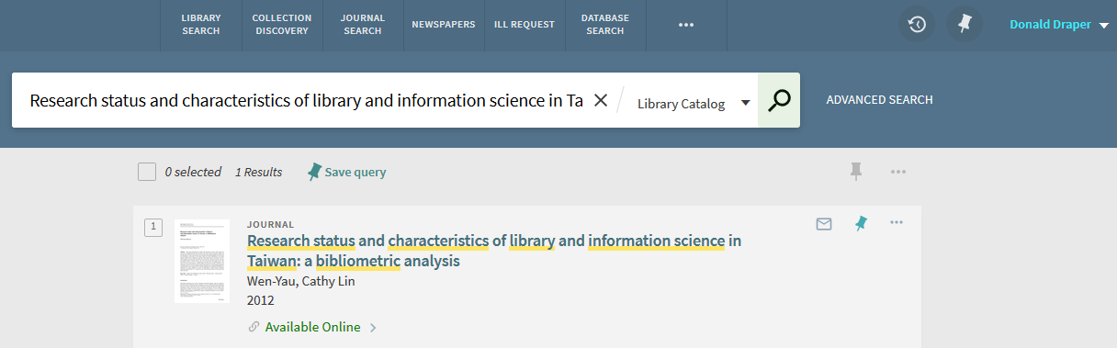
Configuring Access Rights Policies example one
Donald tries to access the digital object

Slide 31
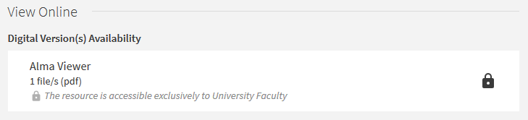
Configuring Access Rights Policies example one
Donald cannot access the digital object
This is the “Denied note” we put in the Access Rights Policy

Slide 32
Configuring Access Rights Policies example two

Slide 33
Configuring Access Rights Policies example two
The “Access Rights Policy List” page.
We will now add a new policy

Slide 34
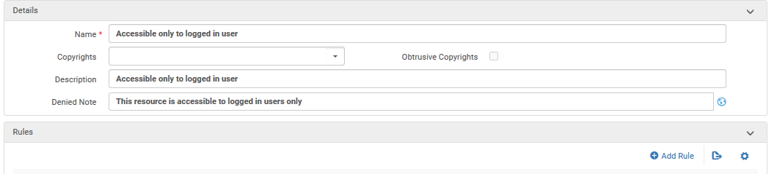
Configuring Access Rights Policies example two
We have called the new policy “Accessible only to logged in user”. We will now add a rule stating that only registered users (registered and authenticated) will be able to access objects with this policy
We will discuss the copyrights later in the presentation
We will later see the “Denied Note” in use
Let’s add a rule

Slide 35
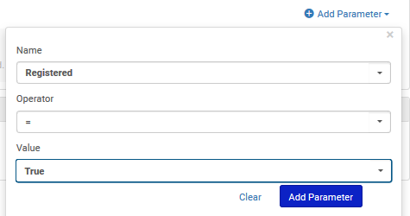
Configuring Access Rights Policies example two
First we will define that “Registered = “True”.

Slide 36
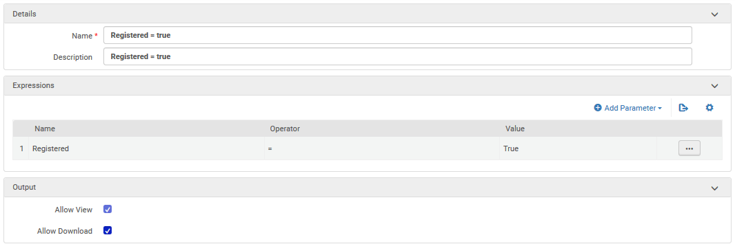
Configuring Access Rights Policies example two
If the user is registered
Then allow view and download

Slide 37
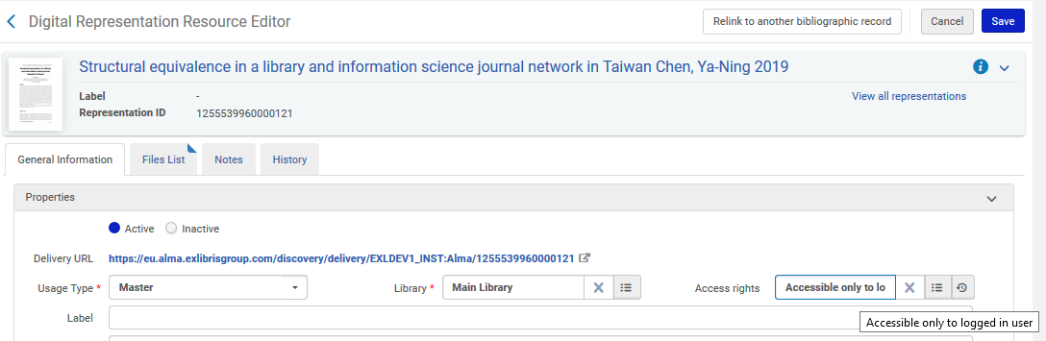
Configuring Access Rights Policies example two
The new access right policy has been added to representation for title “Structural equivalence in a library and information science journal network in Taiwan…”

Slide 38
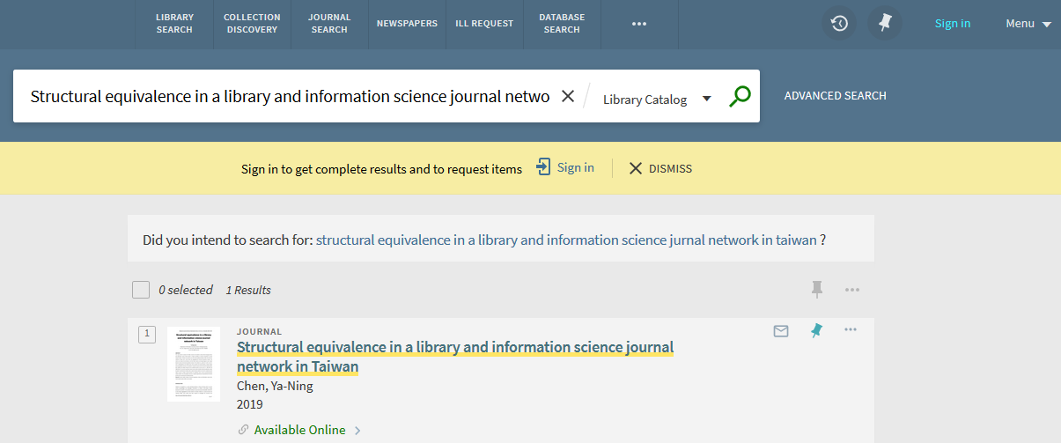
Configuring Access Rights Policies example two
A guest (not logged in) will try to access the digital object
User is not logged in

Slide 39
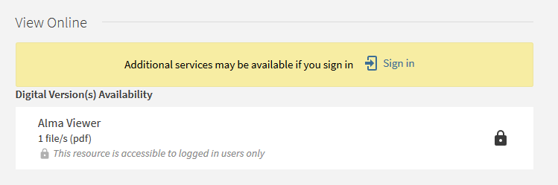
Configuring Access Rights Policies example two
The non logged in user cannot access the digital object
This is the “Denied note” we put in the Access Rights Policy

Slide 40
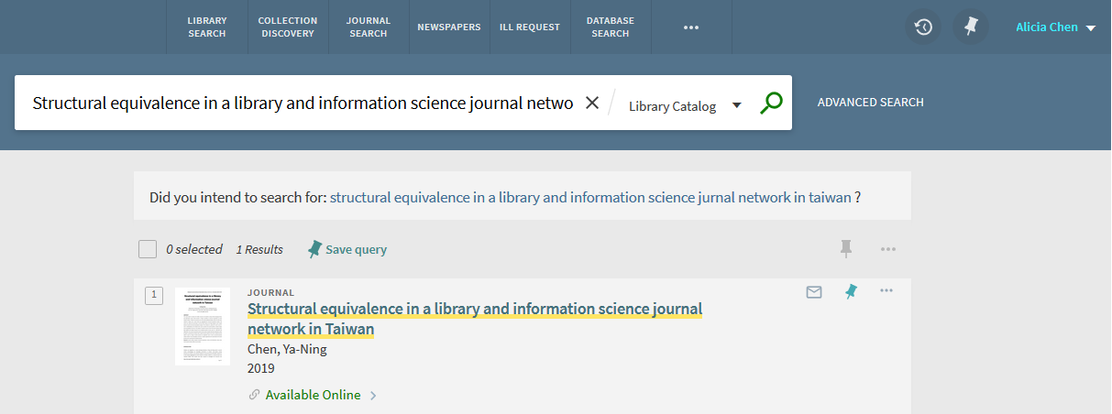
Configuring Access Rights Policies example two
Alicia tries to access the digital object

Slide 41
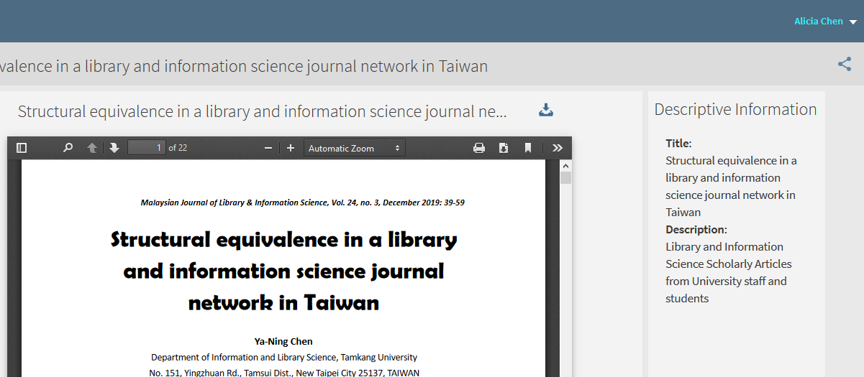
Configuring Access Rights Policies example two
Alicia can access the digital object

Slide 42
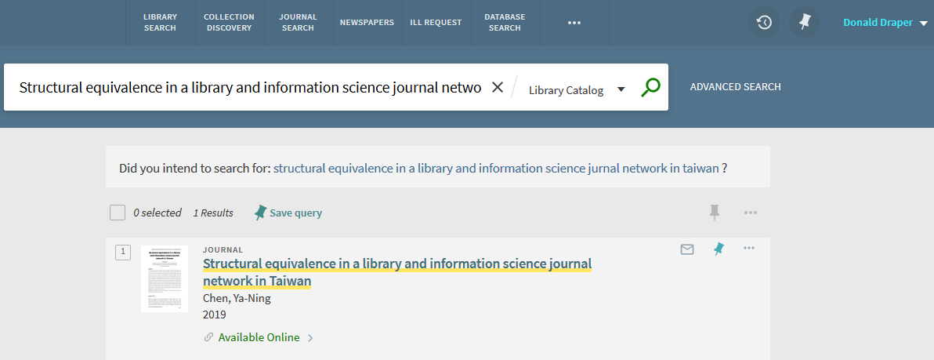
Configuring Access Rights Policies example two
Donald tries to access the digital object

Slide 43
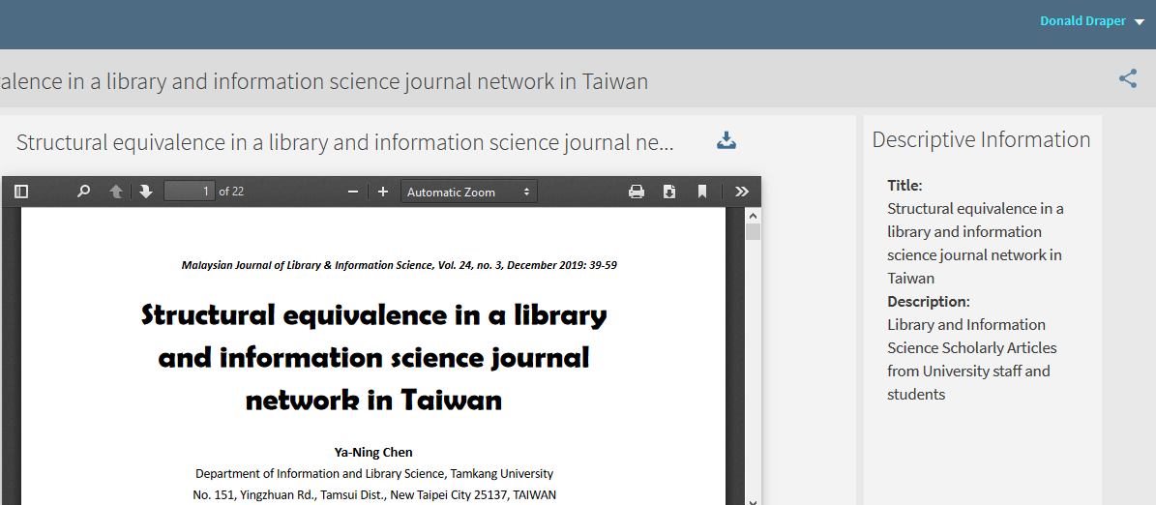
Configuring Access Rights Policies example two
Donald can access the digital object

Slide 44
Copyright declarations

Slide 45
Copyright declarations
The Copyright declarations work as follows:
The institution defines up to 5 copyright declarations.
A copyright declaration can then be applied to an access rights policy.
If a copyrights declaration is applied to an access rights policy then
  If “Obtrusive Copyrights” is not checked the end user will see an indication that there is a copyright and when viewing the object will have an option to view the copyright declaration.
  If “Obtrusive Copyrights” is checked the end user will automatically see the copyright declaration before viewing the object and need to click “close” to view the object

Slide 46
Copyright declarations
We will now do two examples:
In the first example we will attribute a copyright declaration to an access rights policy and not check “Obtrusive Copyrights”
In the second example we will attribute a copyright declaration to an access rights policy and also check “Obtrusive Copyrights”

Slide 47
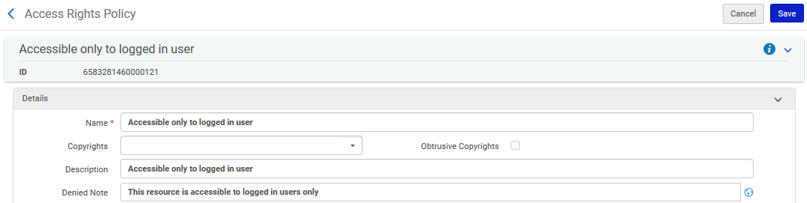
Copyright declarations
For further information on this topic see Configuring Digital Resource Copyright Declarations
The copyrights which may be associated with the access rights come from the files copyrights1.html – copyrights5.html
This is where the copyrights declaration will be applied in the access rights policy.

Slide 48
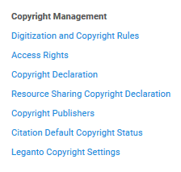
Copyright declarations
Files copyrights1.html – copyrights5.html are accessed at “Configuration > Fulfillment > Copyright Management > Copyright Declaration”

Slide 49
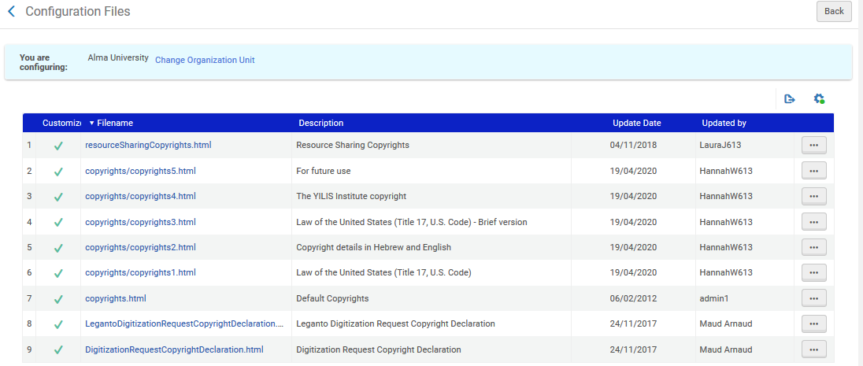
Copyright declarations
Copyright declarations for access rights
We will look at “The YILIS Institute copyright”

Slide 50
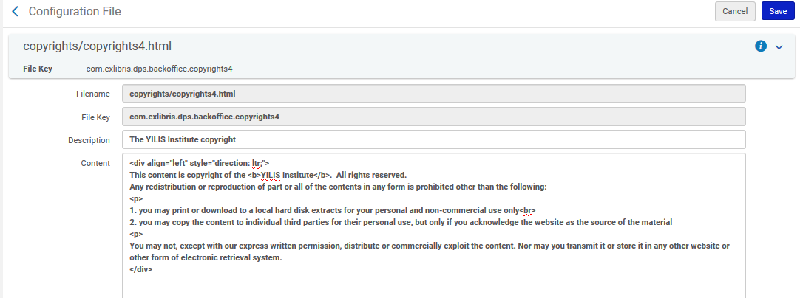
Copyright declarations

Slide 51
Copyright declarations
Here is the text we have added for the “content”
<div align="left" style="direction: ltr;">
This content is copyright of the <b>YILIS Institute</b>. All rights reserved.
Any redistribution or reproduction of part or all of the contents in any form is prohibited other than the following:
<p>
1. you may print or download to a local hard disk extracts for your personal and non-commercial use only<br>
2. you may copy the content to individual third parties for their personal use, but only if you acknowledge the website as the source of the material
<p>
You may not, except with our express written permission, distribute or commercially exploit the content. Nor may you transmit it or store it in any other website or other form of electronic retrieval system.
</div>

Slide 52
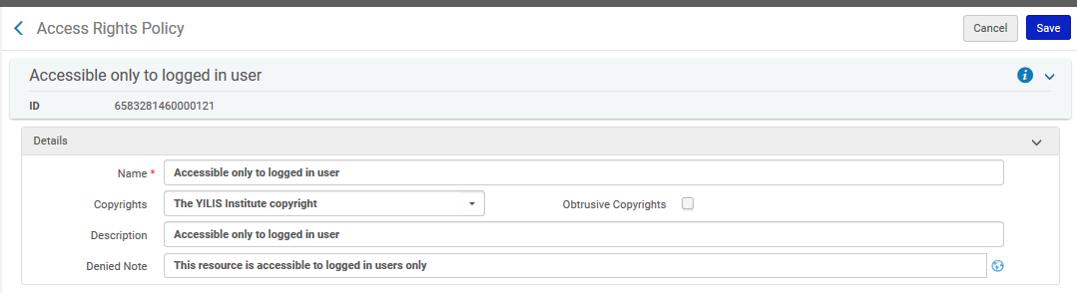
Copyright declarations
First Example
Now we will attribute this copyright declaration to the access rights policy “Accessible only to logged in user”
Added the copyrights declaration here
We did not check “Obtrusive Copyrights”

Slide 53
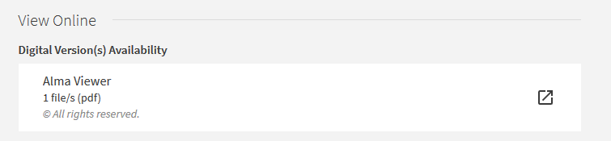
Copyright declarations
First Example
Now when a user accesses a digital object using this policy …
It is evident that there is a copyright

Slide 54
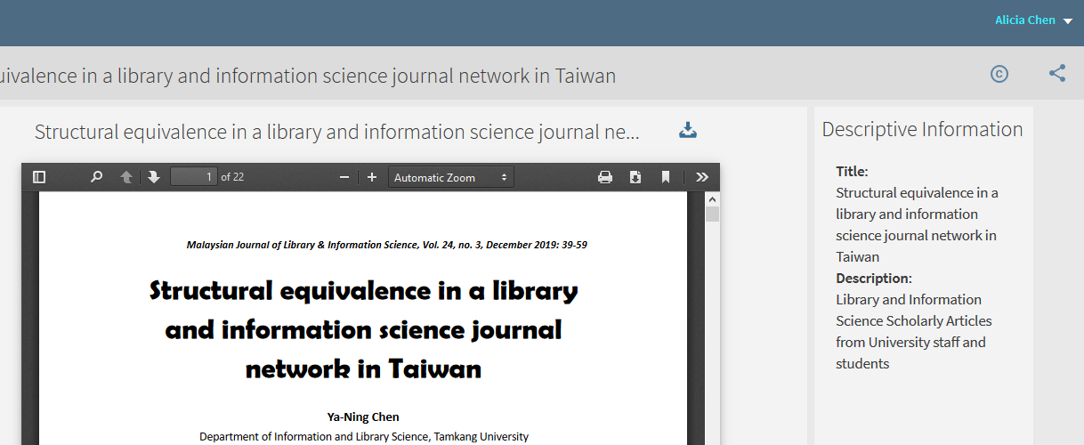
Copyright declarations
First Example
The viewer includes a link to the copyright

Slide 55
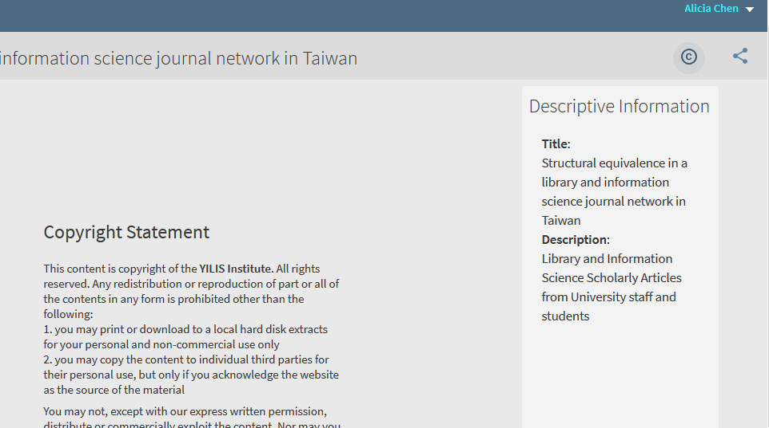
Copyright declarations
First Example
The copyright appears after clicking the link

Slide 56
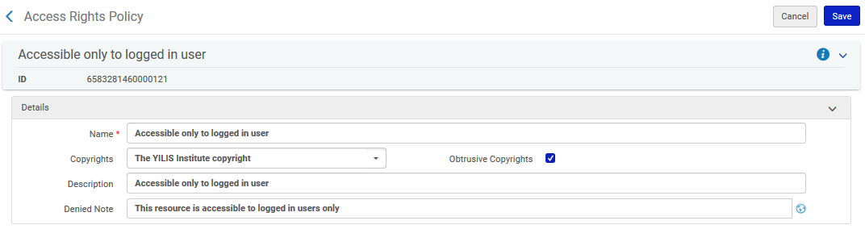
Copyright declarations
Second Example
Now we will still use “The YILIS Institute copyright” in the access rights policy “Accessible only to logged in user”, and we will also check “Obtrusive Copyrights”
We do check “Obtrusive Copyrights”

Slide 57
Copyright declarations
Second Example
Now when a user accesses a digital object using this policy …
It is evident that there is a copyright.

Slide 58
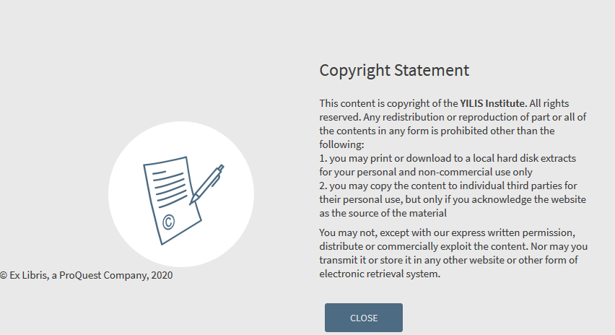
Copyright declarations
Second Example
The user immediately views the copyright and must click “close” to view the object.

Slide 59
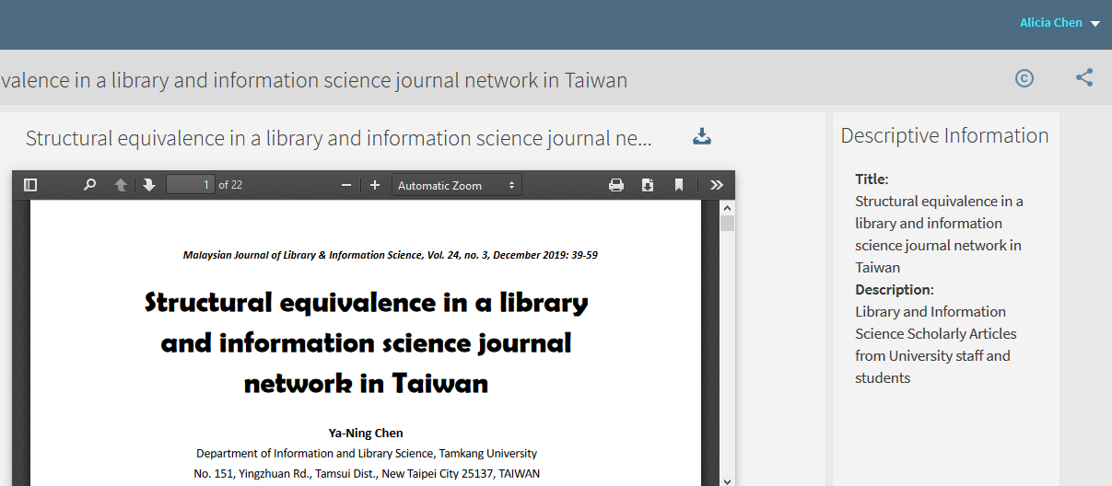
Copyright declarations
Second Example
After clicking “close” on the copyright the object appears

Slide 60
Thank you!
xxx@exlibrisgroup.com

